Slide 1
Census Data Integration for SUSTAIN
Menuka Warushavithana

Slide 2
GeoIDs
GEOIDs are numeric codes that uniquely identify all administrative/legal and statistical geographic areas for which the Census Bureau tabulates data.
Notes:
Census data provided by the US Census Bureau
GeoIDs - Census data identified using GeoIDs
GeoIDs are used to identify data specific to a certain geographical area.

Slide 3
GEOID Structure for Geographic Areas
Area Type | GEOID Structure | Number of Digits | Example Geographic Area | Example GEOID
State | STATE | 2 | Texas | 48
County | STATE+COUNTY | 2+3=5 | Harris County, TX | 48201
County Subdivision | STATE+COUNTY+COUSUB | 2+3+5=10 | Pasadena CCD, Harris County, TX | 4820192975
Places | STATE+PLACE | 2+5=7 | Houston, TX | 4835000
Census Tract | STATE+COUNTY+TRACT | 2+3+6=11 | Census Tract 2231 in Harris County, TX | 48201223100
Block Group | STATE+COUNTY+TRACT+BLOCK GROUP | 2+3+6+1=12 | Block Group 1 in Census Tract 2231 in Harris County, TX | 482012231001
Block* | STATE+COUNTY+TRACT+BLOCK | 2+3+6+4=15 (Note – some blocks also contain a one character suffix (A, B, C, ect.) | Block 1050 in Census Tract 2231 in Harris County, TX | 482012231001050
Congressional District (113th Congress) | STATE+CD | 2+2=4 | Connecticut District 2 | 902
State Legislative District (Upper Chamber) | STATE+SLDU | 2+3=5 | Connecticut State Senate District 33 | 9033
State Legislative District (Lower Chamber) | STATE+SLDL | 2+3=5 | Connecticut State House District 147 | 9147
ZCTA ** | ZCTA | 5 | Suitland, MD ZCTA | 20746

Slide 4
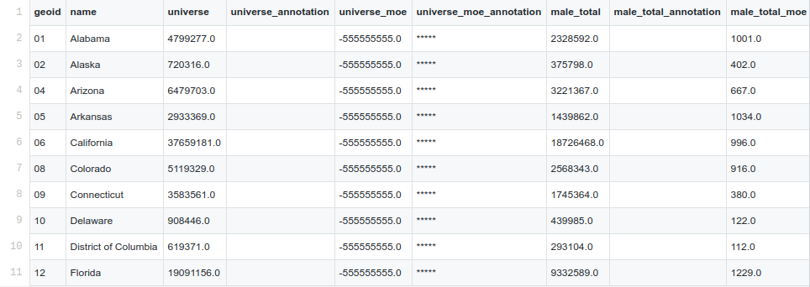
Extracted Data - State Level

Slide 5
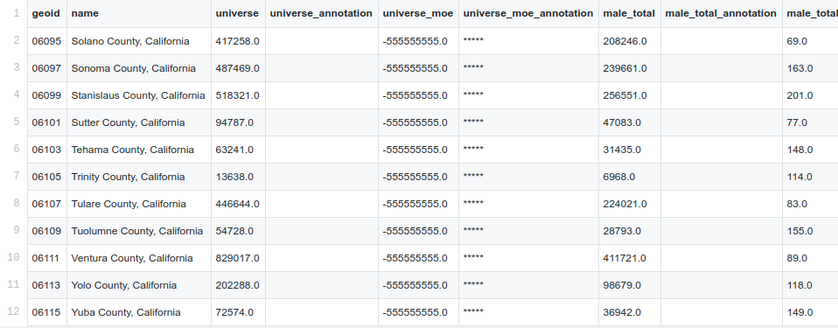
Extracted Data - County Level

Slide 6
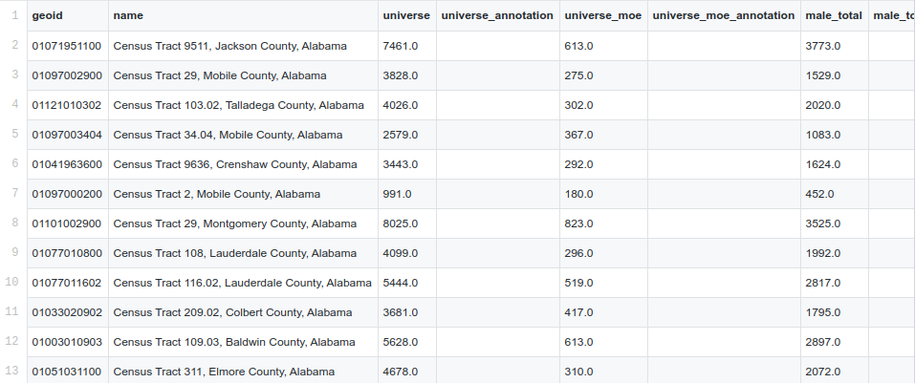
Extracted Data - Census Tract Level

Slide 7
Querying Census Data
Given a single pair of coordinates <latitude, longitude>
Resolving coordinates to GeoIDs
Functionality available in uscensusbureau/citysdk - Implemented using TIGERweb Web Map Service (WMS)
Could not find the underlying algorithm of this conversion
Could invoke the TIGERweb Web Map service ourselves → leads to network latencies
Given a bounding box i.e. two pairs of bounding coordinates
Bounding box information available only to county level
https://www2.census.gov/geo/pvs/tiger2010st/06_California/06001/
Notes:
Challenge - query data on a specific category (income, for example), specific to a geographical area.
There are two ways in which we can provide to geographical area as inputs.
As a single point - as a pair of coordinates
This is available. - but what are trying to build is a visualization application
The goal is to implement this functionality ourselves, starting from raw data.
For visualization of data - we need to retrieve data given a bounding box

Slide 8
References
https://www2.census.gov/geo/pdfs/maps-data/data/FAQ_for_Census_Bureau_Public_Geocoder.pdf
https://github.com/uscensusbureau/citysdk
https://www.census.gov/programs-surveys/geography/guidance/geo-identifiers.html
https://www2.census.gov/geo/pvs/tiger2010st/06_California/06001/

Slide 9
April 14, 2020
Enumerate all geohash prefixes for North America with a certain length.
Convert each of these geohash prefixes into lat/lon pairs (there are libraries to do that) - You will be getting the lat/lon for the centroid of the area defined by the geohash prefix.
Convert the resulting lat/lon pairs into geoIds by following the approach you've already figured out.
Store the census data with geohashes as the spatial component.
Figure out:
1. The smallest viable geohash prefix length. If the area defined with 7 characters, it is a 153m * 153m area (~1647 square feet) which is way smaller than a census block (minimum ~30,000 square feet). Shorter geohash prefixes (<= 6 characters), define larger areas than a census block.
2. There can be cases where the area defined by a geohash may fall into more than one census tract. In such cases, you can simply assume the census tract to which the centroid is mapped or come up with a sophisticated scheme to merge data from multiple census tracts.

Slide 10
(Latitude,Longitude) → GeoID
Bounding coordinates for the U.S. (including Alaska, Hawaii, Puerto Rico): (-171.79, 18.91, -66.96, 71.35)
Latitudes from 18 to 72, Longitudes from -171 to -66
With 1.00 increments
54 x 105 (= 5670) API invocations
With 0.01 increments (to roughly match geohashes of length 5)
4900 x 5000 (= 24,500,000) API calls
A single call takes almost 1 second
Could try with a relatively small area first (Ex:- NYC)

Slide 11
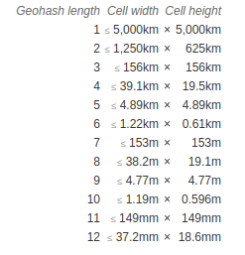
Geohashes

Slide 12
Census Blocks and Census Tracts
Census Blocks
The minimum size of a census block was 30,000 square feet (0.69 acre) for polygons bounded entirely by roads, or 40,000 square feet (0.92 acres) for other polygons. There was no maximum size for a census block [ref].
Census Tracts
Census tracts are small, relatively permanent statistical subdivisions of a county.
Uniquely numbered in each county with a numeric code
Census tracts average about 4,000 inhabitants
Minimum Population – 1,200
Maximum Population – 8,000 [ref]

Slide 13
Census Data
 |  | 2010 | 2000 | 1990 | 1980
Population | State | ✓ | ✓ | ✓ | ✓
 | County | ✓ | ✓ | ✓ | ✓
 | Tract | ✓
Population (Categorized by age) | State | ✓
 | County | ✓
 | Tract | ✓
Poverty | State | ✓
 | County | ✓
 | Tract | ✓
Median Age | State | ✓
 | County | ✓
 | Tract | ✓
Median Household Income | State | ✓ | ✓ | ✓ | ✓
 | County | ✓ | ✓ | ✓ | ✓
 | Tract | ✓
Race | State | ✓
 | County | ✓
 | Tract | ✓

Slide 14
Queries - Type 1
Request: (census feature, latitude, longitude, resolution, decade)
Response: Value(s)
Example Request: (total population, 24.5, -82.0, state, 2000)
Example Response: 15,982,378

Slide 15
Queries - Type 2*
Request: (census feature, comparison operator, comparison value, resolution, decade)
Response: Geographical Areas satisfying the given predicate
Example Request: (total population, >=, 10000000, state, 2010) - states where population is greater than 10 million
Example Response:
GeoID | State
12 | Florida
36 | New York
48 | Texas
6 | California
17 | Illinois
39 | Ohio
42 | Pennsylvania
*Type 2 is only available for population and median income and is limited to a single input condition.

